Slide 1
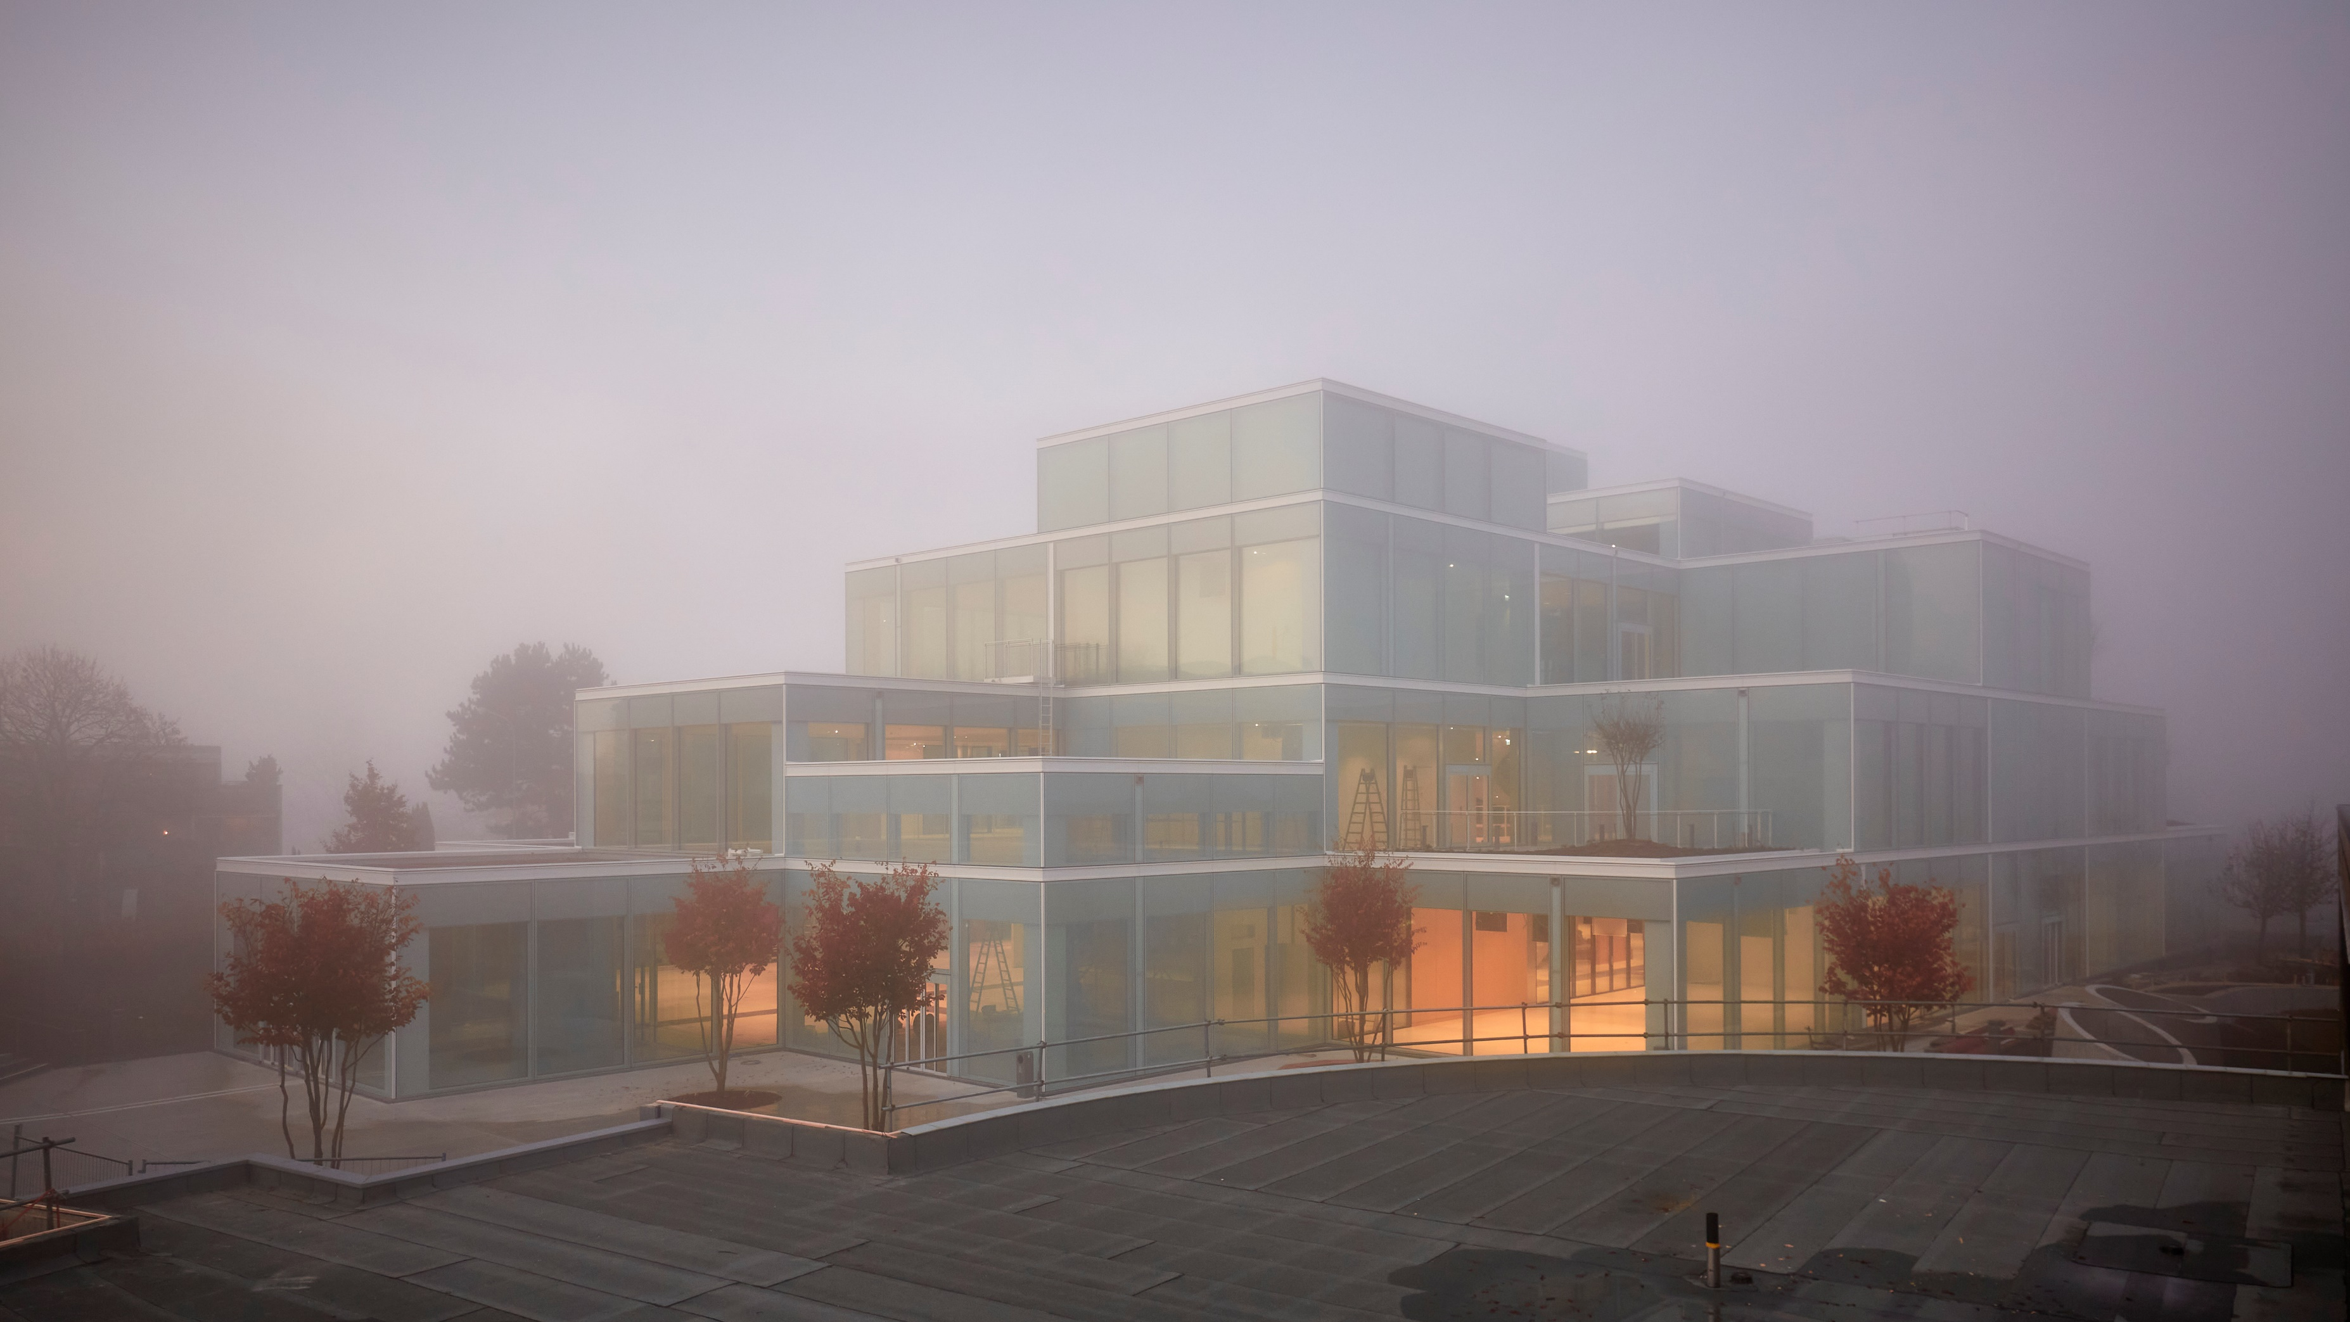

Using Supervised Machine Learning To Predict Telco Customer Churn
Mathias Steilen
Name
Name
Name

Slide 2
Agenda
Item 1
And so forth

Slide 3
The Data

Slide 4
Description of how and where we got the data
Source: Kaggle (IBM)
Goal of the modelling project

Slide 5
Exploratory Data Analysis (EDA)
A brief overview over the most striking relationships

Slide 6
Insert Content and Chart
EDA

Slide 7
Building the models
Splits, Folds, Preprocessing, Hyperparameter Tuning, Training

Slide 8
Insert Content and Chart

Slide 9
Model Performance
Measuring model performance and comparing models

Slide 10
Insert Content and Chart

Slide 11
The Business Case
How does all of this generate value in practice?

Slide 12
Insert Content and Chart
Profit Curves Charts:
By which metric we selected the model in the hyperparameter tuning (ROC AUC, Accuracy etc.)
Comparing between models -> Final conclusion which model should be used

Slide 13
Ethics Discussion
Potential pitfalls in practice

Slide 14
Insert Content and Chart

Slide 15
Q&A
?
?
?

